Slide 1
JOB FIT PRO
TEAM MEMBERS:
HARSAVARDHINI R - 221801016
KAVIYA S - 221801024
MONISHA M - 221801034

Slide 2
INTRODUCTION
Job FitPro is an innovative platform designed to automate and enhance the recruitment process by leveraging Meta Llama 3.1 8B, a large language model. It streamlines resume filtering, candidate matching, and ranking, allowing companies to efficiently identify top talent while minimizing manual effort. The platform is tailored to improve accuracy, scalability, and the overall candidate experience, making recruitment faster, fairer, and more effective.

Slide 3
EXISTING SYSTEM
Manual Screening:The traditional recruitment process heavily relies on manual resume screening, which is labor-intensive and time-consuming. HR teams have to go through a large volume of applications, which slows down the hiring process and can result in delays.
Application Tracking System:ATS software automatically screens resumes by parsing them for keywords related to the job description (e.g., skills, qualifications). Resumes are ranked based on how well they match the job criteria.
AI-Powered Screening:Uses advanced algorithms, including natural language processing (NLP) and machine learning, to better understand the context of a candidate's experience, skills, and qualifications. It can also learn from previous hiring decisions to improve screening accuracy over time.

Slide 4
ADVANTAGES OF EXISTING SYSTEM
Efficiency: Automates the initial screening process, significantly reducing the time spent on reviewing resumes.
Scalability: Handles large volumes of applications, making it easier to manage high applicant numbers.
Keyword Matching: Quickly identifies resumes that closely match the job description through keyword searches.
Data-Driven: Uses data to make informed decisions, potentially improving the quality of hires

Slide 5
DISADVANTAGES OF EXISTING SYSTEM
Keyword Dependence: May overlook qualified candidates who don’t use exact keywords, leading to missed opportunities.
Limited Soft Skill Assessment: Focuses on quantifiable data, often failing to evaluate crucial soft skills.
Transparency Issues: Lack of clarity for candidates on why they were rejected, leading to dissatisfaction.
Formatting Issues: Can struggle with non-standard resume formats, resulting in misinterpretation of data.

Slide 6
PROPOSED SYSTEM
The proposed system leverages the power of Meta Llama 3.1 8B, a large language model, to automate and enhance the process of resume screening. The system is designed to handle resumes and job descriptions in PDF format. It automatically extracts the "skills" section from each resume and compares it with the required skills listed in the job description. The system then generates a percentage score that reflects how well each candidate’s skills match the job requirements.
The process begins by uploading multiple resumes and a job description into the system. The system extracts the necessary content, such as the candidate's name and skills, and feeds it into the LLM as part of a prompt. The LLM analyzes this information and outputs a percentage score indicating the suitability of the candidate for the given role. The system then iterates through all resumes in the folder, providing a comparative analysis across candidates.

Slide 7
ADVANTAGES OF PROPOSED SYSTEM
Advanced Skill Recognition: By utilizing Meta Llama 3.1 8B, the system can recognize advanced and niche skills that might not be explicitly listed but are inferred from the candidate's experience. This allows for a more comprehensive evaluation of a candidate's qualifications.
Efficiency: The automation of resume screening reduces the time and effort required for manual analysis, enabling recruiters to focus on more strategic tasks.
Data-Driven Decisions: The percentage score provided by the LLM gives a clear, quantifiable metric for decision-making, helping recruiters to prioritize candidates more effectively.
Scalability: The system can handle a large volume of resumes, making it suitable for organizations with extensive hiring needs.

Slide 8
DISADVANTAGES OF PROPOSED SYSTEM
Dependency on Model Accuracy: The system's effectiveness is heavily dependent on the accuracy of the language model. If the LLM misinterprets the context or nuances of the skills, it could lead to incorrect rankings.
Limited Human Judgment: While the system automates the screening process, it may overlook certain qualitative aspects that a human recruiter would consider, such as cultural fit or potential for growth.
Potential Bias: If the LLM has inherent biases in its training data, these could be reflected in the evaluation process, leading to biased outcomes.

Slide 9
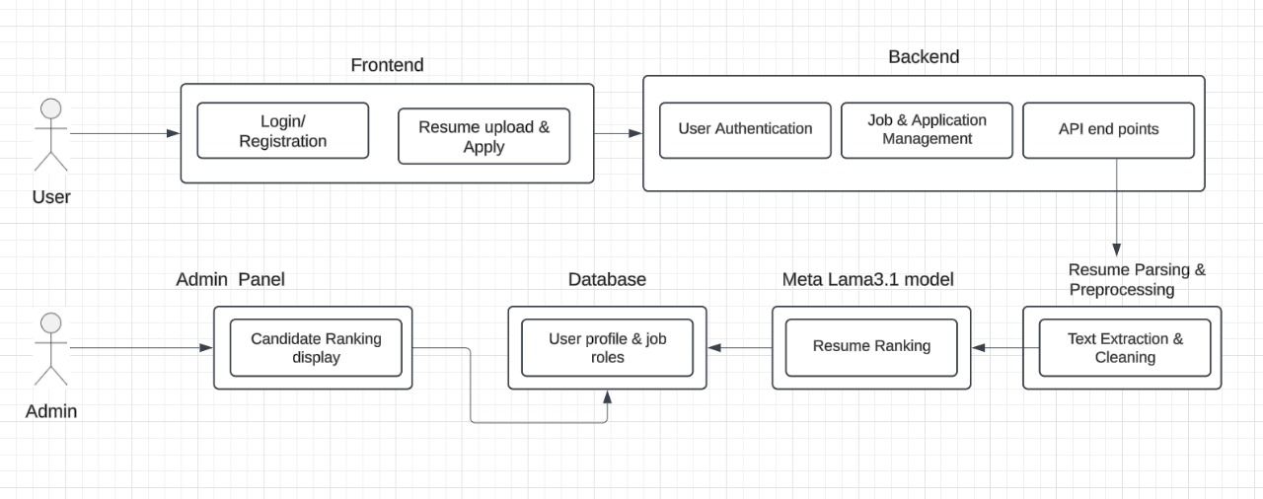
SYSTEM ARCHITECTURE

Slide 10
SYSTEM ARCHITECTURE EXPLANATION
The system architecture for the AI-driven resume filtering system leveraging Meta Llama 3.1 is designed with a modular and layered approach, ensuring optimized processing of user data, seamless application of machine learning algorithms, and effective presentation of results. This architecture is built to support scalability, flexibility, and maintainability, crucial for handling complex resume analysis and matching tasks. Below is an in-depth overview of each core component and its role in the Architecture.

Slide 11
Module 1: User Interface
• Role: Provides an intuitive platform for candidates to interact with the system. Users can log in, search for relevant job roles, upload resumes, and submit their applications.
• Technologies: Built using HTML, CSS, and JavaScript to create a responsive and user-friendly interface. The UI allows for easy navigation and interaction.
• Features: Includes job search, resume upload, application submission, and feedback display.

Slide 12
Module 2: Backend (Django Framework)
Role: Manages all interactions between the frontend, database, and Meta Llama 3.1 model. The backend is responsible for user authentication, job data management, resume processing, and handling requests from the frontend.
Technologies: Built with Django, a Python-based framework that facilitates secure, scalable, and maintainable web applications.
Components:
User Authentication & Authorization: Handles login and security protocols.
Job & Application Management: Manages job postings, applications, and deadline checks.
API: Provides endpoints for frontend requests, including resume submission and application status updates.
Resume Processing: Extracts and preprocesses resume data to prepare it for AI model analysis.

Slide 13
Module 3: Resume Parsing & Preprocessing
• Role: Extracts and cleans data from uploaded resumes to prepare them for AI processing.
• Technologies: Libraries like PyPDF2 and nltk for text extraction and natural language processing. The system handles tokenization, lemmatization, and other preprocessing steps.
• Process: Text data is extracted, standardized, and formatted to ensure compatibility with Meta Llama 3.1.

Slide 14
Module 4: Meta Llama 3.1 Model (AI-based Resume Filtering)
• Role: The core component that ranks resumes based on relevance to job descriptions. It evaluates candidates by matching their qualifications, skills, and experiences to job requirements.
• Technologies: PyTorch and Hugging Face Transformers are used to implement and run the Meta Llama 3.1 model.
• Process: After resumes are preprocessed, they are fed into the model, which outputs a ranking score. Resumes are then sorted based on their scores, identifying the top candidates.

Slide 15
Module 5: Database
• Role: Stores user profiles, job roles, applications, and resume data.
• Technologies: Relational databases like MySQL or PostgreSQL, or a NoSQL database like MongoDB.
• Data Management: Manages structured data for candidate profiles, job details, and ranked resumes, enabling efficient retrieval during admin review.

Slide 16
WATERFALL MODEL
For the Job Fit Pro project, which automates resume filtering for companies using the Meta Llama 3.1 8b instruct model, we followed the Waterfall Model, a structured, sequential development approach. In the Requirements Gathering and Analysis phase, we collaborated with stakeholders to identify core functionalities, such as user login, job search, application submission, and resume ranking, while determining the technical stack (Django for the backend, HTML/CSS for the frontend, and Meta Llama for ML-based resume evaluation).

Slide 17
WATERFALL MODEL
During System Design, we planned a robust architecture, defining components like User, JobPosting, Application, and Admin, and developed UI mockups for intuitive navigation. The Implementation phase saw the translation of design into code, with Django handling backend logic and ML model integration for automated resume filtering. Frontend development ensured a user-friendly interface for candidates and admins. Unit Testing was performed on each module to ensure functionality, covering areas like login, application submission, and resume ranking.

Slide 18
WATERFALL MODEL
Following this, the system was deployed, with Django and Meta Llama seamlessly integrated, ensuring smooth user interaction. Finally, maintenance plans were established for ongoing system monitoring and updates. The Waterfall Model facilitated a clear, methodical progression through each phase, ensuring that each requirement was thoroughly addressed before moving on to the next, providing a stable foundation for the final application.

Slide 19
UNIT TESTING
Test Case 1: UploadedFilesModelTest
Description: This test creates mock files (resume2.pdf for resume and job_description.pdf for the job description) using SimpleUploadedFile. It then instantiates the UploadedFiles model with these files and verifies if the stored resume file name starts with "resumes/resume2", ensuring files are saved with a structured naming convention.

Slide 20
UNIT TESTING
Test Case 2: ResumeAnalysisFunctionTest
Description: This unit test directly tests the analysis function, using a mock resume text containing technical skills and a job description text with similar requirements. The test checks if the function returns a response containing a "percentage" key, indicating the match score between resume and job description.

Slide 21
UNIT TESTING
Test Case 3: FileUploadViewTest
Description: This test simulates a file upload and text submission through the Django test client. A sample PDF file (resume2.pdf) and job description text are provided. The test then posts this data to the upload_resume view, validating that the response status is 200 and contains the expected keyword ("result") to confirm successful processing.

Slide 22
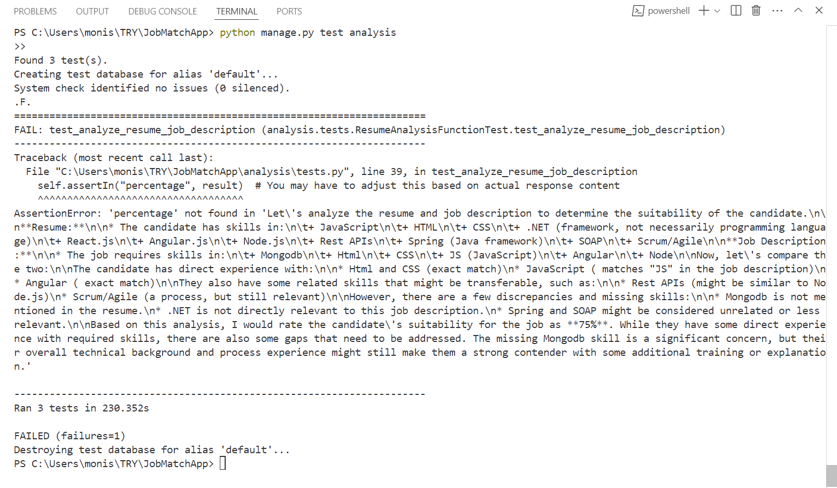
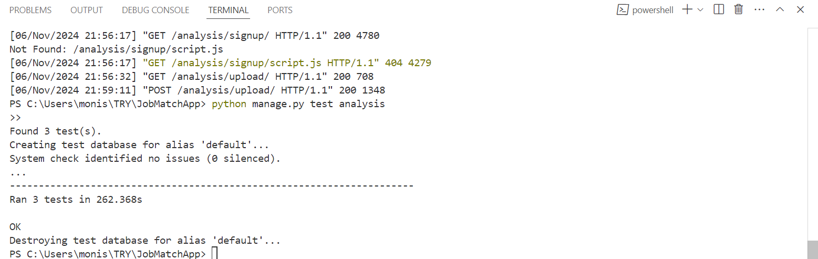
TESTING OUTPUTS

Slide 23
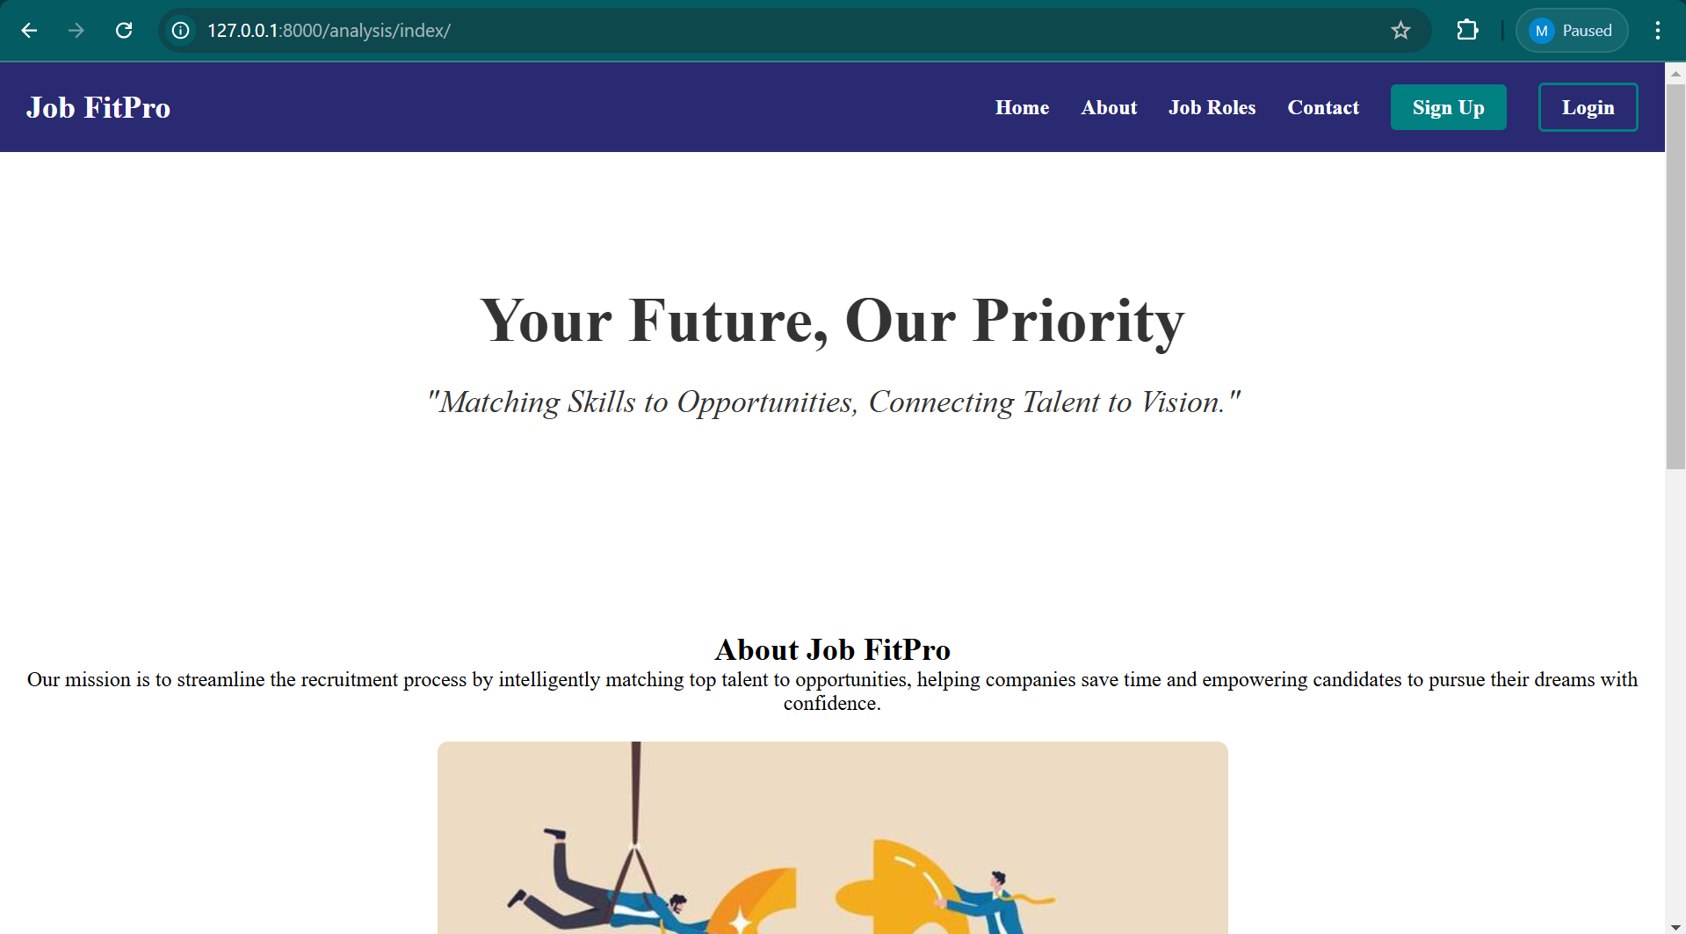
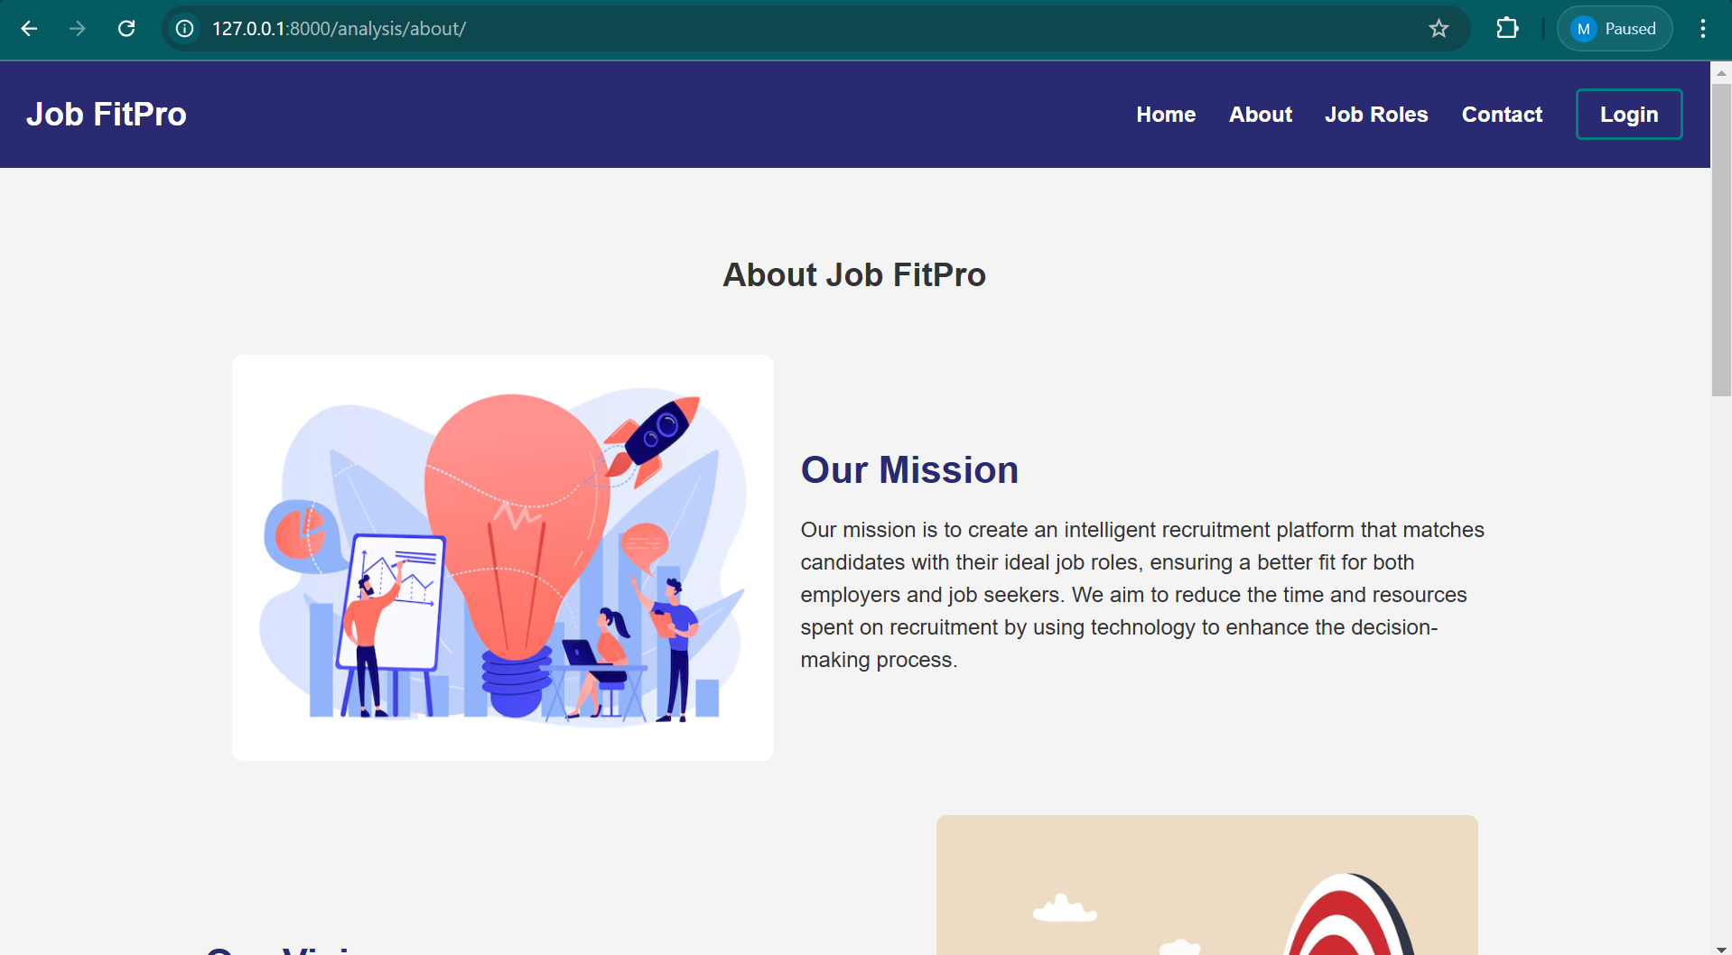
SAMPLE OUTPUTS

Slide 24
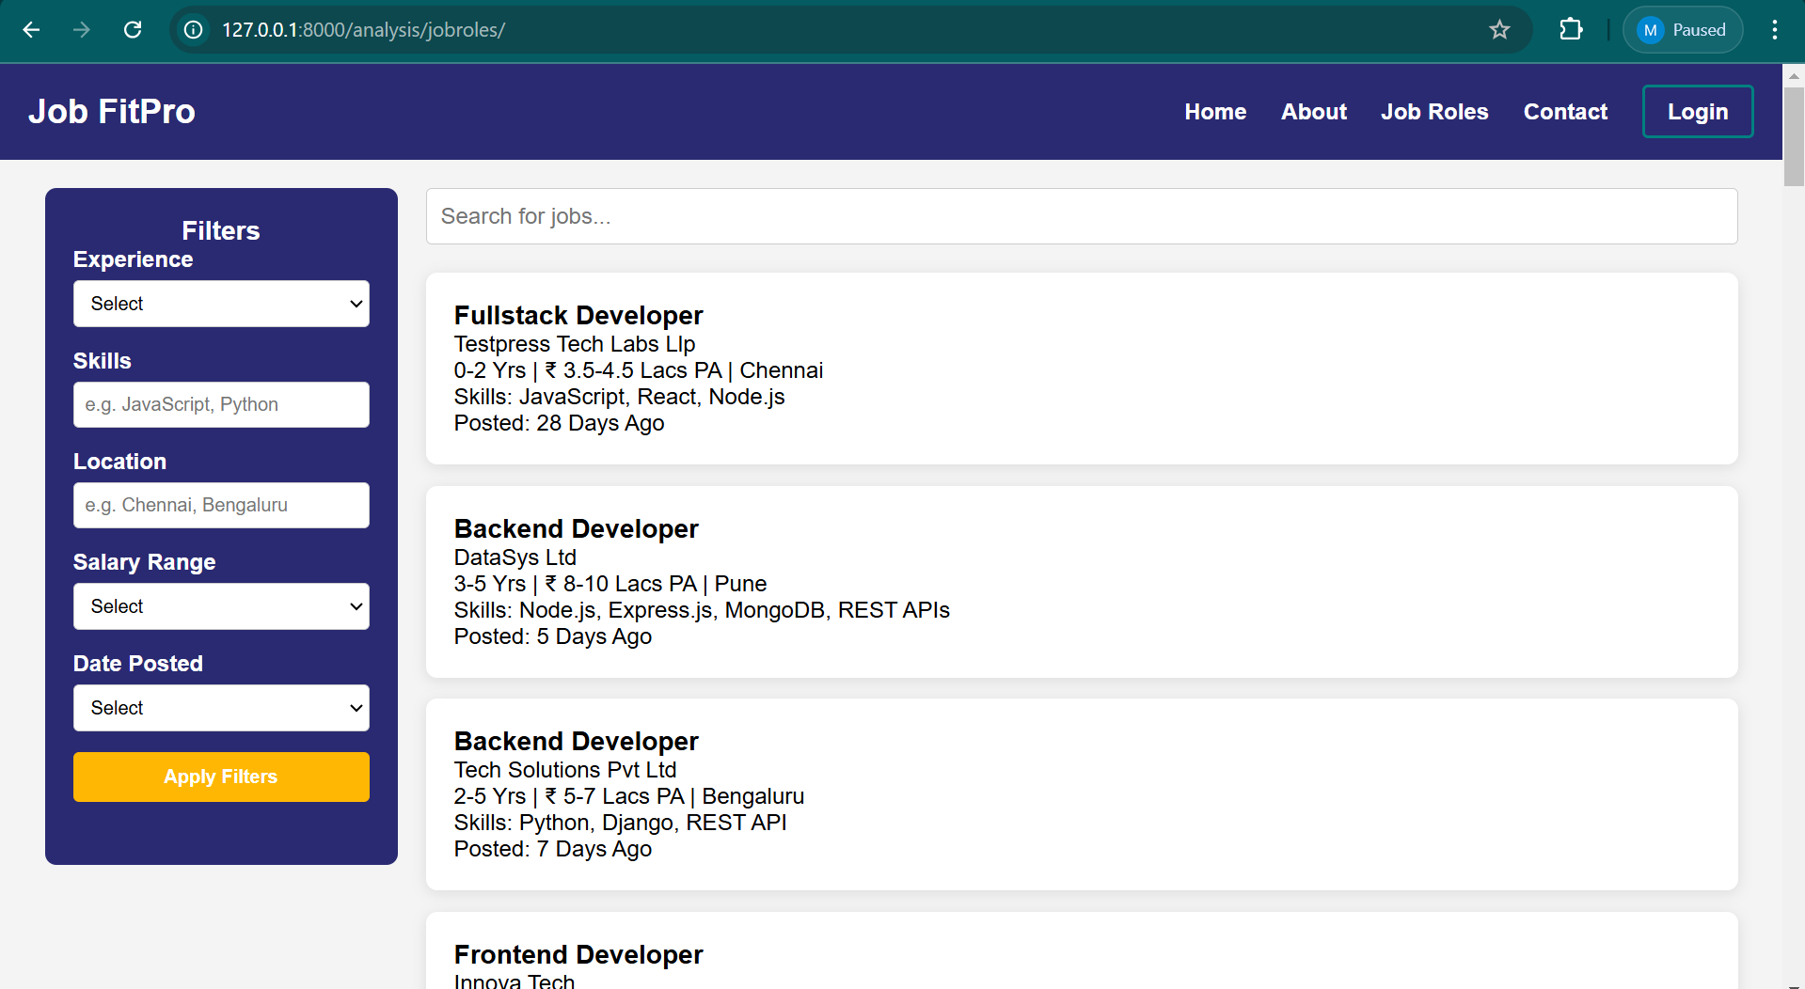
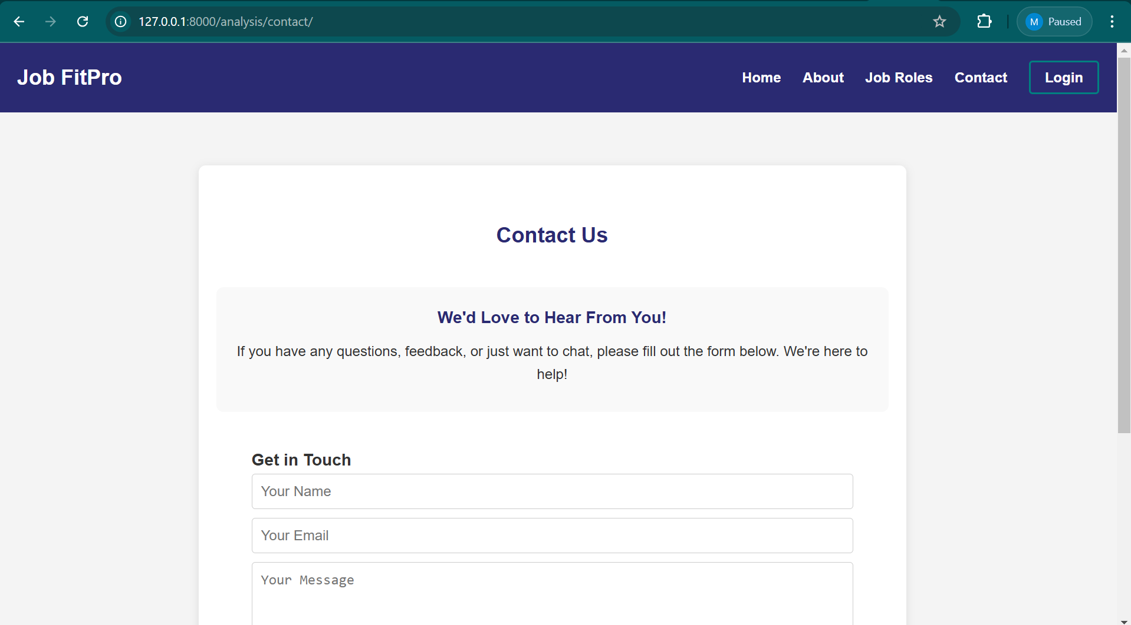
SAMPLE OUTPUTS

Slide 25
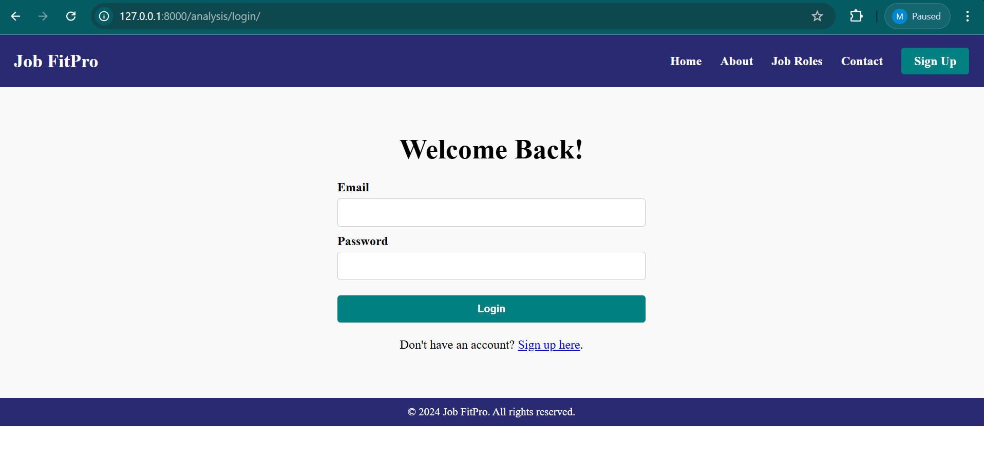
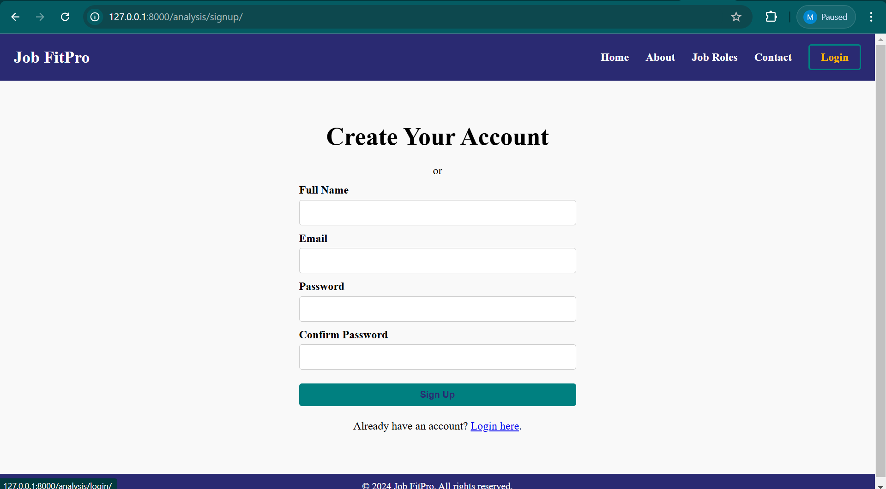
SAMPLE OUTPUTS

Slide 26
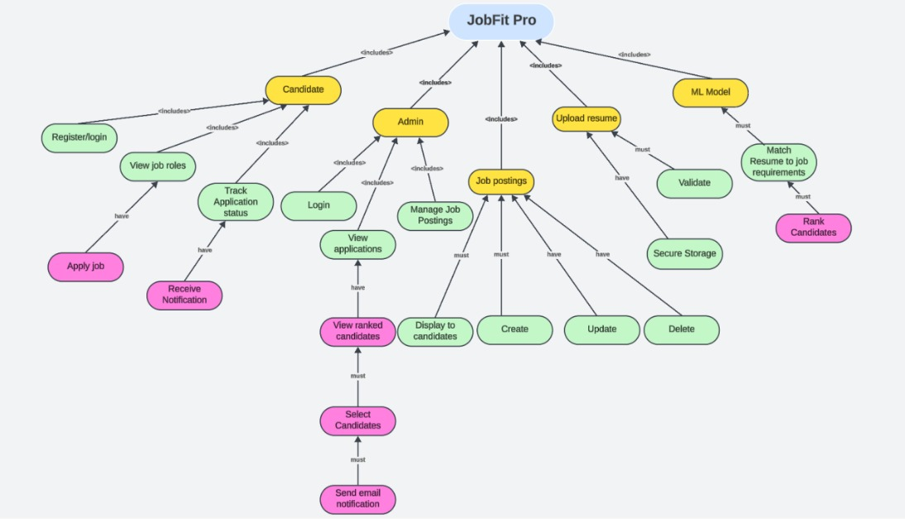
CONCEPT DIAGRAM

Slide 27
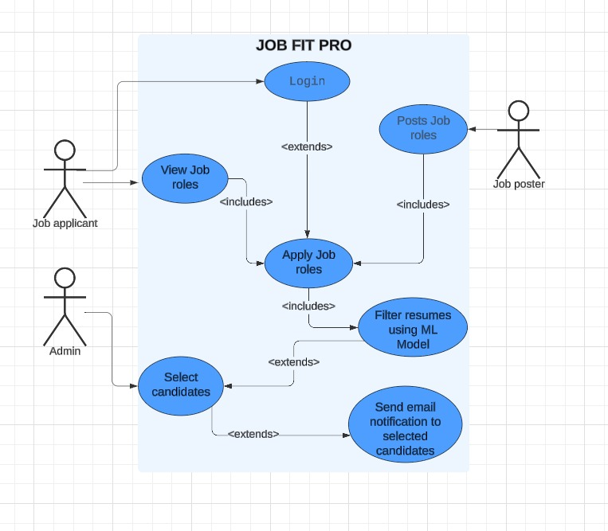
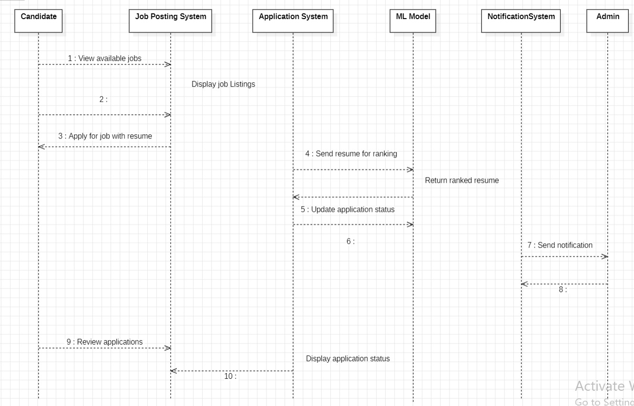
OBJECT ORIENTED DESIGN
Use Case Diagram
Sequence Diagram

Slide 28
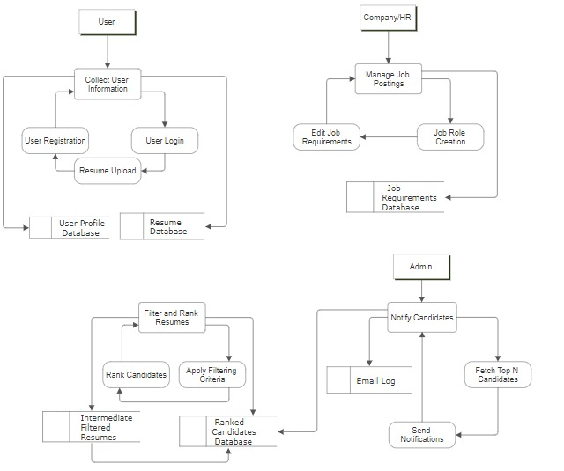
DATA FLOW DIAGRAM

Slide 29
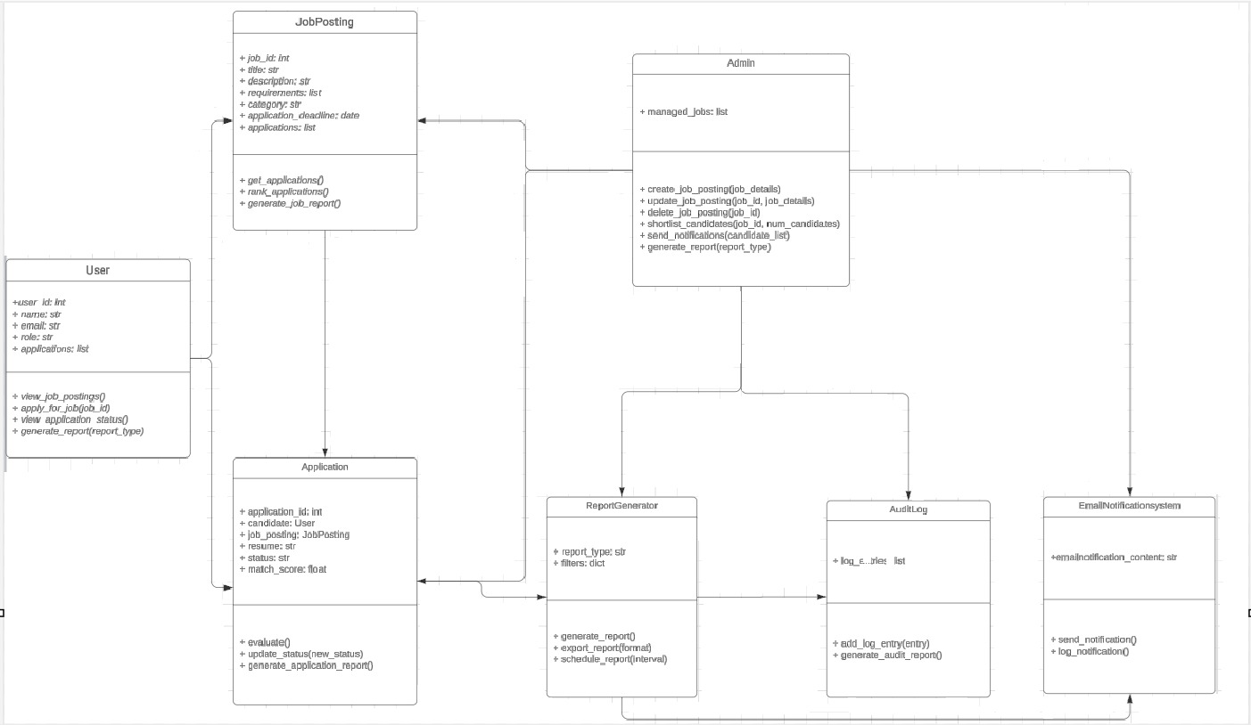
OBJECT ORIENTED DESIGN
Class Diagram

Slide 30
RESULTS AND DISCUSSION
The Job Fit Pro project leverages the Meta Llama 3.1 model to streamline resume filtering, enabling job seekers to log in, find roles, and submit applications. Built with Django, it offers job management and accurate resume ranking, identifying top candidates based on job requirements. The frontend ensures a user-friendly experience, and initial testing shows robust functionality. Further integration testing and user feedback could improve performance, scalability, and user experience.

Slide 31
FUTURE SCOPE
Future enhancements for Job Fit Pro could include more integration testing for scalability, fine-tuning the Meta Llama model for industry-specific accuracy, and leveraging user feedback to refine ranking algorithms and the UI. Expanding support for diverse job roles and adding features like real-time notifications and performance analytics would increase platform value. Cloud-based model deployment could further enhance scalability, positioning Job Fit Pro as a highly efficient and unbiased recruitment solution.

Slide 32
CONCLUSION
The Job Fit Pro project automates resume filtering using the Meta Llama 3.1 model, ranking candidates by resume-job match criteria. Job seekers submit details and resumes, while employers can efficiently review top candidates. Built with Django, the backend manages user authentication, job postings, and model integration, with a responsive HTML/CSS frontend. Email alerts for application statuses improve usability, offering a streamlined recruitment experience.

Slide 33
REFERENCES
[1]K. Nakamura, S. Tanaka, and Y. Nagano, "Using Natural Language Processing for Resume Screening and Job Matching," IEEE Transactions on Engineering Management, vol. 67, no. 3, pp. 840-851, Sept. 2020.
[2]L. Tunstall, L. von Werra, and T. Wolf, Natural Language Processing with Transformers: Building Machine Learning Solutions Using BERT and GPT-3, O’Reilly Media, 2022.
[3]N. Gupta and R. Jain, “A Comparative Study of Techniques for Matching Job-Description and Resumes Using NLP,” International Journal of Computer Applications, vol. 176, no. 41, pp. 20-27, Aug. 2020.
[4]M. Chang and P. Kumar, "Evaluating Resume Parsing Techniques Using Machine Learning for HR Applications," IEEE Access, vol. 8, pp. 72345-72354, 2020.

Slide 34
REFERENCES
[5]L. Prokhorenkova, G. Gusev, A. Vorobev, A. V. Dorogush, and A. Gulin, “CatBoost: unbiased boosting with categorical features,” arXiv preprint arXiv:1810.11363, 2018.
[6]P. Aggarwal and R. Sharma, “An NLP-Based Approach for Automated Resume Screening and Matching,” IEEE International Conference on Advances in Computing, Communication, & Automation (ICACCA), pp. 1-6, Oct. 2021.
[7]A. Păduraru, L. Oprea, and D. Moldoveanu, "Efficient Resume Screening Using Text Processing and Machine Learning," IEEE 23rd International Conference on System Theory, Control and Computing (ICSTCC), Sinaia, Romania, pp. 1016-1021, 2019.
[8]D. Jurafsky and J. H. Martin, Speech and Language Processing: An Introduction to Natural Language Processing, Computational Linguistics, and Speech Recognition, 3rd ed., Pearson, 2023

Slide 35
Thank you

